Slide 1
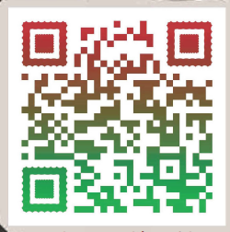
NORTHSIDE POST OFFICE
FAST PASS
What is a Fast Pass?
A fast pass awards you with the opportunity to forgo the long lines at the Post Office so you can more efficiently pick up your package.
3-5 HOURS = 1 FAST PASS
5-7 HOURS= 2 FAST PASSES
7 HOURS = 4 FAST PASSES
8+ HOURS = 5 FAST PASSES
How do you qualify for a Fast Pass?
You can volunteer with us for 3 or more Hours.
How and When can I Volunteer?
During the Holiday season, we are here from 0900-1900 every day. Just come to the Post Office’s Main entrance and walk through the Finance section. There will be a door on the left-hand side with a volunteer sign. Simply knock on the door and let us know that you’re interested in volunteering. You can also sign-up to volunteer on the QR code below.

