Slide 1
Welcome
Private Organizations
to our
3rd Quarter Meeting
September 20, 2022

Slide 2
Private Organization's Office General Information
Website www.https://86fss.com/private-organizations/
AFI’s
Frequently Asked Questions
Templates
Fundraiser Request Form
Private Organization Administrator
Mrs. Catherine Jennings
Private Org box: 86FSS.privateorgs@us.af.mil
Email: Catherine.Jennings.1@us.af.mil
DSN: 480-8728/06371-47-8728
Location: Building 2118 (Vat Office) 2nd Floor, Office 220

Slide 3
Agenda For Today
Review general organization information
Fundraising Opportunities
Legal
Unite Program
Questions

Slide 4
Official Organization or Unofficial Activities ?
Official Private Organizations:
Have a bank account that exceeds over $1000 in an average of 3 months.
Have a need for by-laws, constitution and Insurance/waiver.
Unofficial Activities:
Have a bank account that does not exceed over $1000 in an average of 3 months.
Small unofficial activities include coffee funds, flower funds, sunshine funds, and other small operations are generally not considered official private organizations.

Slide 5
Unofficial Activity Recurring Documents
Unofficial Activity’s Yearly Documentations (change of officers)
Officers list
Bank Authorization Form
Must have Wet Signatures by all members on the form.
Account name must match the UA’s name on the current account.
Failure to renew, will force the bank to close the account.
Bank will send a letter through the mail, prior to closing the account.
Unofficial Activity's Letter.
Unofficial Activity's Letter is routed up through the POs’ Office.
Then routed up to the FSS Commander for final approval.
Takes up to 7 days for approval.
A copy of the approved letter will be provided to the UA.

Slide 6
How To Stay Compliant
Unofficial Activities
Unofficial Activities’ letter is not expired.
Yearly Schedule
1 Jan –31 Dec
Minutes and Financial’ s statements due no later than 15 Jan.

Slide 7
Official Organization’s Recurring Documents
Official Organization’s yearly (when officers change)
Officers list
Bank Authorization form
Must have Wet Signatures by all members on the form.
Account name must match the UA name on the current account.
Failure to renew, will force the bank to close the account.
Bank will send a letter via mail, prior to closing the account.
Must have a proof of insurance. Only exception is if the PO has activities that involve only minimal risks of loss or damage, on behalf of the membership. Then a insurance waiver may apply and must be renewed yearly.

Slide 8
Official Organization’s Recurring Cont…
Official Organization’s in alternate years
Bylaws (Signed by at least the current President)
Constitution (Signed by as least the current President)
Recharter Letter
Fill out the name of the organization.
Email to PO’s office.
Can take up to 14 business days for approval from MSG CC.
An approved copy will be sent back to PO.

Slide 9
How To Stay Compliant
Official Organization
Charter packet is not expired.
Insurance/Waiver is not expired.
Minutes and Financial’ s statements have been turned in for each quarter.
Quarterly Schedule
1 Jan – 31 March
Minutes and Financial’ s statements due no later than 15 April
1 April – 30 June
Minutes and Financial’ s statements due no later than 15 July
1 July – 30 Sept
Minutes and Financial’ s statements due no later than 15 Oct
1 Oct – 31 Dec
Minutes and Financial’ s statements due no later than 15 Jan

Slide 10
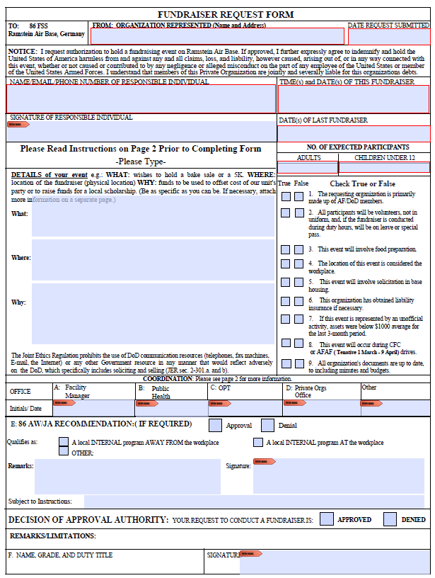
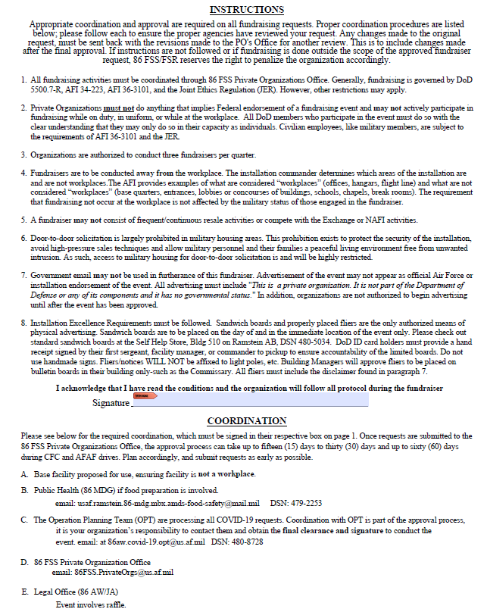

Slide 11
Army Private Organization Office
Ms. Naomi Mcloud
USAG RP - FMWR, Private Organizations Liaison
Phone Number is 541-9085 / 0611-1435419085
Group Email: usarmy.rheinland-pfalz.id-europe.mbx.dfmwr-unit-funds@mail.mil
https://kaiserslautern.armymwr.com/programs/private-organization-information

Slide 12
Looking to have a 5K?
Submit request with enough lead time, a few days to get the request
signed will not equal good results.
If the event leaves the Fitness Center property, and will requires other Sq involvement like SFS or Medical the request must be submitted to the Gatekeeper for approval.
Communication with Fitness Program and events Coordinator is a must, please coordinate with both to deconflict prior to submission. This will ensure we don’t have two 5Ks back to back etc.
Submit e-SSS a minimum of 60 days before event to allow proper time for coordination and approval from MSG/CC.
You will receive a 786 FSS 5K Guidance to help you.

Slide 13
Looking to have a 5K?
All Fitness programs and events have priority as it is a mandated program.
Ensure your event does not conflict with any base, wing events. Refer to the 86 AW strat calendar on SharePoint and/or contact the 86 AW front office to verify that no events conflict with the date/time you have chosen
Useful Phone Numbers/Contact Information
786 FSS/FSVS: 480-0294
86 SFS Police Services: 478-2232
Outdoor Recreation: 480-5707
CES Self Help Store: 480-5034/5035
Ramstein Public Address Support: 480-5137 or email at: ramstein.publicaddresssupport@ramstein.af.mil
86 AW/SE: 480-7233
86 AW/PA: 480-9196
86 AW/AT: 480-2115
86 MSG/CCE: 480-2000

Slide 14
Looking to have a 5K?
eSSS Guidance:
Routing:
(your sq/CC or org president)
786 FSS/FSVS (Mr. Marcus Grothues)
786 FSS/FSV
786 FSS/CC
86 FSS/CC (for private orgs only)
86 SFS/CC
86 AW/SE
86 AW/PA
86 AW/AT
86 MDG/CC
86 MSG/CCE
86 MSG/CD
86 MSG/CC for approval

Slide 15
Looking to do a Bagging Fund Raiser
Contact the Commissary about what availability is for fundraising.
Have the manager sign the request form as the facility manager and turn it back into the PO’s Office.
Since your PO is bagging, all tips are yours.
You may have multiple days or weekends (within 30 days) on one fundraiser request.
We do allow Army POs to take place in either Commissary Bagging.

Slide 16
Commissary POC’s
Christopher Orosco Pearl Cardiel-Santos Ciara Willingham Scott Huckins Jacob Phillips
Contact Info
Ramstein.Commissary@deca.mil
☎ Comm: +49 (0)6371-47-6712 / 7159 / 7231
☎ DSN: 480-6712 / 7159 / 7231

Slide 17
Gift Wrapping
Sign up date has not been released yet.
POs from the Army, Dodea, Scouts and Air Force can participate.
No last minute cancelations or your PO could be refrained from participation the next year.
Your PO receives limited wrapping paper from the BX. All tape, name tags, scissors and bows are to be brought by the PO.
Wrapping dates are between Black Friday and up to the Christmas Eve.
More details to come next month.

Slide 18
Fundraising During the CFC and AFAF
Ad hoc fundraising efforts should generally not interfere with, or detract from, the Combined Federal Campaign(CFC) or Air Force Assistance Fund Campaigns (AFAF) .
Ad hoc fundraising to support unit holiday parties is allowed during the Combined Federal Campaign.
No workplace (desk-to-desk) fundraising or payroll deductions are authorized to support Non-Federal Entities or Private Organizations other than the Air Force Assistance Fund and Combined Federal Campaigns.
Limited workplace (desk-to-desk) fundraising is allowed by unit unofficial activities/social funds.
CFC is currently from 1 September – 15 January

Slide 19
Fundraising – “ For Us By Us”
“For us, by us” fundraising includes activities wherein Unit organizations composed primarily of DoD employees, or their dependents fundraise among their own members for the benefit of welfare funds for their own members or their dependents.”
POs are not considered “for us, by us” fundraising entities within the meaning of the Joint Ethics Regulation, Section 3-210(a)(6).
IAW AFI 36-3101, paragraph 5.3.4.2, allows for “for us, by us” fundraising activities, when small amounts of cash are collected to assist unit members with personal misfortune.
Collections “should be completely voluntary and anonymous.
Employees are not limited in the amount they contribute, however, the amount solicited from employees should not exceed $10.

Slide 20
Fundraising – Raffles
Raffles must be held to support the PO’s routine operations or for the direct benefit of Department of Defense personnel or their family members.
Raffles must be authorized in advance by the Installation Commander or designee through a fundraiser request.
Raffles may not be authorized to raise money for an outside cause local or national group, such as local regional or national charities (including the Combined Federal Campaign).
Raffles may be utilized for the benefit of the Air Force Assistance Fund if 100% of the proceeds are donated to the Fund. See AFI 36-3101, section C.
Raffles must not be conducted by military members or civilian employees during their duty time. Military members may not conduct raffles while in uniform at any time. Air Force personnel may participate in PO fundraising raffles only in a purely personal, unofficial, volunteer capacity at authorized locations and in ways that do not imply official endorsement.
Raffles conducted strictly for a monetary prize are not authorized on the installation.

Slide 21
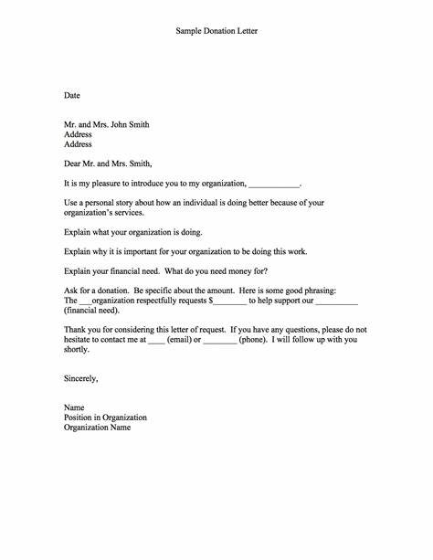
Soliciting Donations
Private Organizations and unit unofficial activities may accept gifts and donations from outside sources.
Unit unofficial activities will not solicit gifts.
Private Organizations will not solicit direct monetary gifts or donations (as distinguished from the sale of items of value) on base.
Off-base solicitations must clearly indicate that they are for a Private Organization and not for the base or any official part of the Air Force.
Donor/gift recognition may not be made publicly.
Oral recognition of the gift or donation can only be made to members of the Private Organization or those present at an event benefiting from the donation/gift.
We currently recommend that POs do not solicit funds from off-base entities during COVID
AFI 34-223 10.19.1.3

Slide 22
Fundraising - CFC & AFAF
The Combined Federal Campaign & the Air Force Assistance Fund Campaign (Service Specific) are the ONLY Official Fundraising Activities within DoD
No workplace (desk-to-desk) fundraising or payroll deductions are authorized to support Non-Federal Entities or Private Organizations other than the Air Force Assistance Fund and Combined Federal Campaigns
PO fundraising may not interfere with, or detract from, the CFC or AFAF
PO ad hoc fundraising to support unit or Private Organization holiday parties is allowed during the Combined Federal Campaign
Approval authority for fundraising during this time is elevated (expect approvals to take longer)

Slide 23
86th Force Support Squadron
Community Cohesion Program
Community Cohesion Coordinator
Ember Miles

Slide 24
Unite Program Intent
Use Force Support Capabilities to:
Help CCs/CLs build & strengthen unit cohesion in AF units
Provide Squadrons with funding to execute programs
NAF Dollars $5/per person assigned
APF Dollars (CY) Check with C3 for dollar amount
Air Force and Space Force Active Duty, Reserve and GS, NAF, and LN civilian employees
Unite funds cannot be used in conjunction with any other funding with exception of BOOSTER CLUB or unit members paying a portion to offset cost
*UNITE funds cannot be used to augment holiday parties

Slide 25
Goals and Objectives
GOAL 1: Support Squadron Commanders
Provide Squadron Commanders the opportunity to select from a menu of innovative program options
GOAL 2: Maximize use of FSS facilities
GOAL 3: Measure Impact
Provide a variety of formal and informal opportunities for socializing, unit cohesion and Esprit de corps
Follow up with units to ensure commanders' needs are being met and that required effects materialize or improve as a result of the unit cohesion activities
GOAL 4: Provide maximum flexibility to squadron leaders
The Unite Initiative guidance sufficiently allows squadron leaders the ability to plan quality events while maintaining funding integrity

Slide 26
Concept of Operations
Provides squadron leaders with maximum flexibility to develop and deliver programs to build cohesion for personnel within their unit
The C3 provides squadron leaders with a list of recommended “Ready to Execute” (RTE) programs for ease of implementation
Squadrons can create “Unit Developed Programs” (UDP) that capitalize on opportunities in the local area
All events, RTE or UDP must be coordinated through the C3 for AFSVC approval for funding in advance of program execution
Additionally, the C3 will assist/advise squadron UNITE Points of Contact develop programs for their squadrons
POC Toolkit
POC Immersion Tours

Slide 27
Ready to Execute Programs
Ready to Execute (RTE)
Programs developed by Air Force Services Center
Pre-approved
Authorized use of APFs
Sample RTEs
Squadron Bowling Day
Pool Parties
Outdoor Recreation Adventure trips
Rod and Gun
Themed Fun Runs
Night golf, Foot golf outings

Slide 28
Unit Developed Programs
Unit-Developed Programs (UDP)
Programs developed locally
Requires advanced approval
Squadron representative(s) coordinate w/Unite Team
Squadron representative(s) complete Event Planning Sheet
C3 submits form to AFSVC for approval
Sample UDPs
Trampoline Park, Escape Rooms
Unit Game Day, Field Day, “Cohesion Days”
Zip lining, Ropes Course
City Scavenger Hunts, City Tours, Museums, Athletic Events

Slide 29
Food Options/Ideas
UNITE NAF funds can be used to provide meals, but only in conjunction with APF-authorized UNITE events!
NAFs authorized for this program are to be utilized for food and non-alcoholic beverages only. Squadrons highly encouraged to partner with local FSS dining establishments to maximize use of these funds
Food and non-alcoholic beverage costs exceeding the allotted per-person funds are the squadron’s responsibility
NAF funds cannot be used to augment Holiday parties
Allocations will be provided to each squadron for the calendar year
UNITE funds are intended for unit/squadron members
Family members can participate but funding is not provided

Slide 30
Questions?

