Slide 1
Welcome
Private Organizations
to our
3rd Quarter Meeting
April 28, 2021

Slide 2
Private Organization's Office General Information
Website www.https://86fss.com/private-organizations/
AFI’s
Frequently Asked Questions
Templates
Fundraiser Request Form
Private Organization Administrator
Mrs. Catherine Jennings
Private Org box: 86FSS.privateorgs@us.af.mil
Email: Catherine.Jennings.1@us.af.mil
DSN: 480-8728/06371-47-8728
Location: Building 2118 (Vat Office) 2nd Floor, Office 220

Slide 3
Guest Speakers' Information
Legal Representative
Captain Clark
86.AW.JA@us.af.mil
Bazar Committee
Amanda Peter
Foodvendor@ramsteinbazaar.org
www.ramsteinbazaar.org/food-vendor-faq

Slide 4
Agenda For Tonight
Review general organization information
Legal
Freedom Fest
Bazar
Questions

Slide 5
Official Organization or Unofficial Activities ?
Official Private Organizations:
Have a bank account that exceeds over $1000 in an average of 3 months.
Have a need for by-laws, constitution and Insurance/waiver.
Unofficial Activities:
Have a bank account that does not exceed over $1000 in an average of 3 months.
Small unofficial activities include coffee funds, flower funds, sunshine funds, and other small operations are generally not considered official private organizations.

Slide 6
Unofficial Activity Recurring Documents
Unofficial Activity’s Yearly Documentations (change of officers)
Officers list
Bank Authorization Form
Must have Wet Signatures by all members on the form.
Account name must match the UA’s name on the current account.
Failure to renew, will force the bank to close the account.
Bank will send a letter through the mail, prior to closing the account.
Unofficial Activity's Letter.
Unofficial Activity's Letter is routed up through the POs’ Office.
Then routed up to the FSS Commander for final approval.
Takes up to 7 days for approval.
A copy of the approved letter will be provided to the UA.

Slide 7
How To Stay Compliant
Unofficial Activities
Unofficial Activities’ letter is not expired.
Yearly Schedule
1 Jan –31 Dec
Minutes and Financial’ s statements due no later than 15 Jan.

Slide 8
Official Organization’s Recurring Documents
Official Organization’s yearly (when officers change)
Officers list
Bank Authorization form
Must have Wet Signatures by all members on the form.
Account name must match the UA name on the current account.
Failure to renew, will force the bank to close the account.
Bank will send a letter via mail, prior to closing the account.
Must have a proof of insurance. Only exception is if the PO has activities that involve only minimal risks of loss or damage, on behalf of the membership. Then a insurance waiver may apply and must be renewed yearly.

Slide 9
Official Organization’s Recurring Cont…
Official Organization’s in alternate years
Bylaws (Signed by at least the current President)
Constitution (Signed by as least the current President)
Recharter Letter
Fill out the name of the organization.
Email to PO’s office.
Can take up to 14 business days for approval from MSG CC.
An approved copy will be sent back to PO.

Slide 10
How To Stay Compliant
Official Organization
Charter packet is not expired.
Insurance/Waiver is not expired.
Minutes and Financial’ s statements have been turned in for each quarter.
Quarterly Schedule
1 Jan – 31 March
Minutes and Financial’ s statements due no later than 15 April
1 April – 30 June
Minutes and Financial’ s statements due no later than 15 July
1 July – 30 Sept
Minutes and Financial’ s statements due no later than 15 Oct
1 Oct – 31 Dec
Minutes and Financial’ s statements due no later than 15 Jan

Slide 11
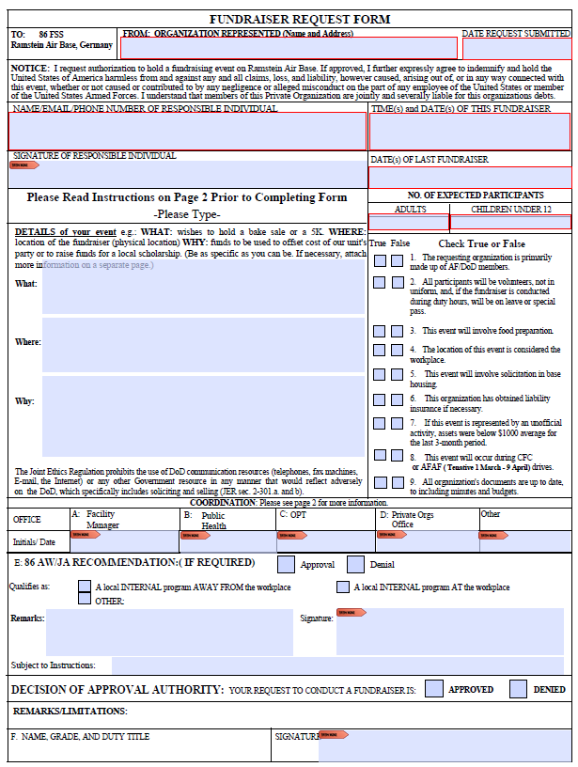
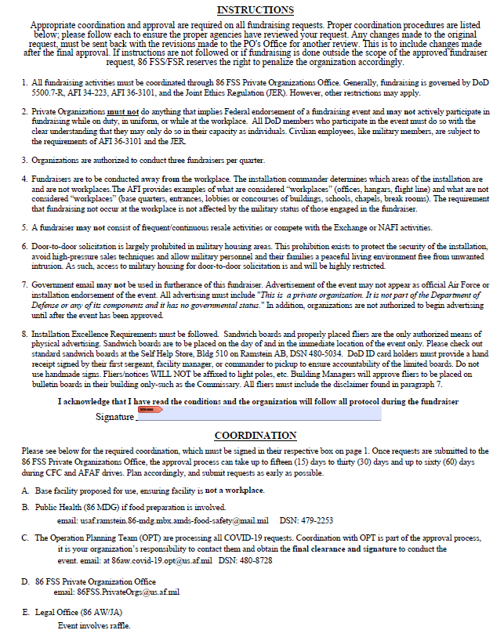

Slide 12
Legal Issues and Private Organizations
Establishing your private organization and the requirements
Insurance requirements
Soliciting donations
Fundraising activities during Covid-19
Fundraising and the commissary

Slide 13
Private Organizations
Private Organizations are self-sustaining special interest groups, set up by individuals acting exclusively outside the scope of any official capacity as members of the Air Force or Federal Government, to include civilians, contractors, Air Reserve and Air National Guard members. They operate on Air Force installations with the written consent of the Installation Commander.
POs are NOT part of the DoD
If your charter package creates the appearance that you are a part of the DoD, our legal recommendation will be to not approve the PO’s charter request and send it back for revisions.

Slide 14
PO Charters- Requirements
Constitution AFI 34-223, chapter 9, paragraphs 9.1-9.4
Bylaws AFI 34-223, chapter 9, paragraphs 9.1-9.4
Certificate of Liability Insurance or Insurance Waiver AFI 34-223, para 10.15

Slide 15
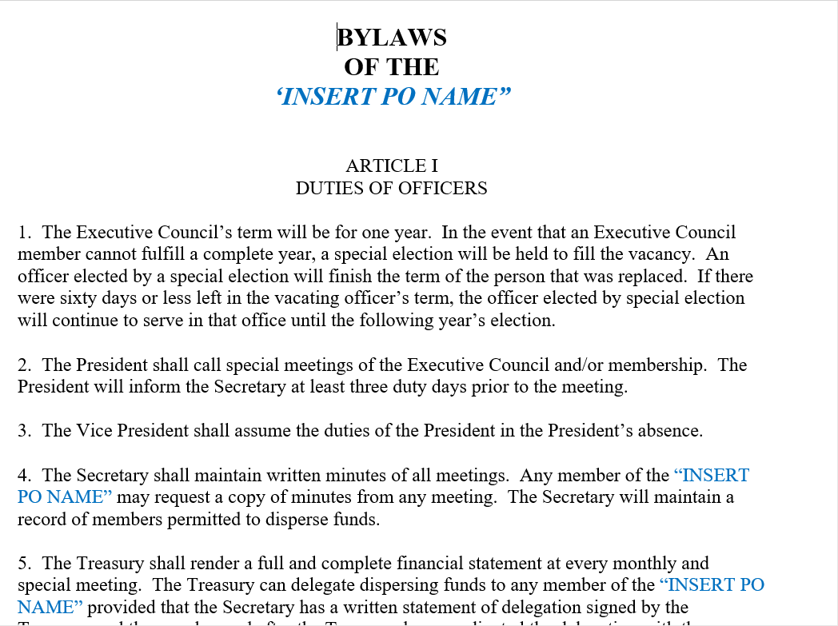
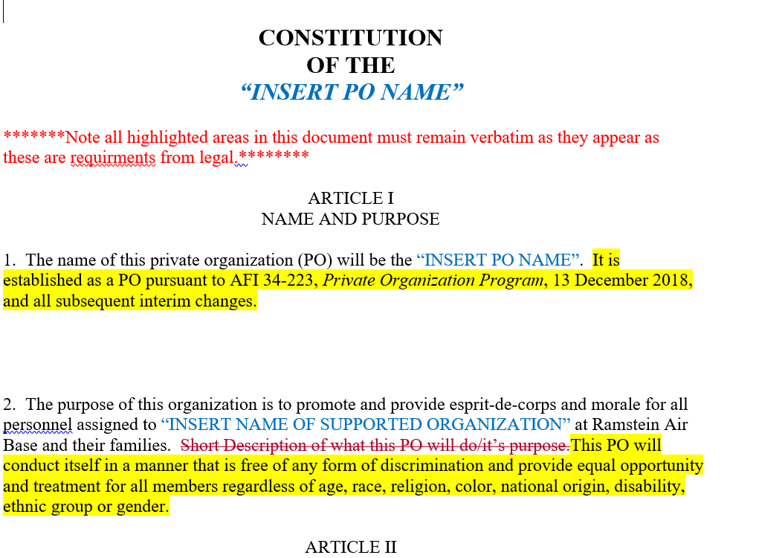
Sample Templates
Following the templates ensures compliance and a high likelihood that they will be approved after our legal review

Slide 16
Let’s Talk About Insurance
PO members are jointly and severally liable for the obligations of the PO, and the absence of liability insurance places their personal assets immediately at risk in the event of PO liability
This means that each member is individually responsible for damages caused the PO activities
Event Insurance - Even if the PO is granted a liability insurance waiver, the commander may still require liability insurance for specific events that involves greater risk of injury or damage (Example: softball tournament)

Slide 17
Sample Template

Slide 18
Soliciting Donations
Private Organizations and unit unofficial activities may accept gifts and donations from outside sources.
Unit unofficial activities will not solicit gifts.
Private Organizations will not solicit direct monetary gifts or donations (as distinguished from the sale of items of value) on base.
Off-base solicitations must clearly indicate that they are for a Private Organization and not for the base or any official part of the Air Force.
Donor/gift recognition may not be made publicly.
Oral recognition of the gift or donation can only be made to members of the Private Organization or those present at an event benefiting from the donation/gift.
We currently recommend that POs do not solicit funds from off-base entities during COVID
AFI 34-223 10.19.1.3

Slide 19
Fundraising - CFC & AFAF
The Combined Federal Campaign & the Air Force Assistance Fund Campaign (Service Specific) are the ONLY Official Fundraising Activities within DoD
No workplace (desk-to-desk) fundraising or payroll deductions are authorized to support Non-Federal Entities or Private Organizations other than the Air Force Assistance Fund and Combined Federal Campaigns
PO fundraising may not interfere with, or detract from, the CFC or AFAF
PO ad hoc fundraising to support unit holiday parties is allowed during the Combined Federal Campaign
Approval authority for fundraising during this time is elevated (expect approvals to take longer)

Slide 20
Fundraising During COVID-19
Face-to-Face fundraising may be limited due to installation and/or host nation requirements
POs must have a hygiene plan included with their fundraising request that describes how the activity will meet existing requirements
At a minimum the plan should address: the number of people to be involved, physical distancing, sanitation/PPE, and how the PO will track contacts, etc.
POs must receive the approval from the OPT and Public Health prior to submitting fundraising requests
Approval of fundraisers are subject to change, depending on installation and host nation requirements

Slide 21
Virtual Fundraising events are an option
Virtual Sporting Events
Online Zoom Events –avoid events that involve gambling or the appearance thereof.
Online Gaming Events

Slide 22
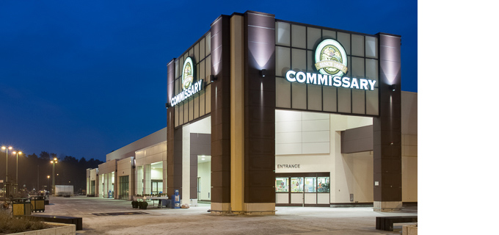
Fundraising and the Commissary
Due to NATO SOFA and Customs requirements, Private Organization fundraising is limited to others with SOFA status.
Use of items purchased through DeCA (the Commissary) or AAFES (the Exchange) is prohibited for home business. A limited exception is allowed for Private Organizations, however direct re-sale is prohibited. (Competition is not allowed)

Slide 23
Freedom Fest
86 FSS has not confirmed or canceled the 2021 Freedom Fest Event. They will make sure to follow all local regulations if the event takes place. Which could allow or deny the event.
Unfortunately, there will be NO PO food booths this year. We do not want anyone to invest money for a booth and then the event is canceled. This was not an easy decision, but we feel this is the best for everyone incase the event is canceled.

Slide 24
FOOD VENDOR KEY POINTS
Space rental fee $200, payable to FSS
Refundable cleaning fee $350, payable to ROSC
220 power required
20x20 space size
13 May: Food Vendor application live @2000 until 14 May @2000
20 May: Food Vendor notified of acceptance or waitlist
3 June: Food Vendor Contract Briefing @ 1000, Hercules Theater
2 August: Food, Fire, and Safety Briefing @ 0800, location TBD
15 September: 0700 check-in and setup begins
POC: Amanda Peter, foodvendor@ramsteinbazaar.org
www.ramsteinbazaar.org/food-vendor-faq

Slide 25
What Information is required on the Application?
Organization Name to be used during the Bazaar (must match the organizational name on file with FSS PO office)
Two points of contact (POC).
Email and phone for both POC's (use of .mil and DSN's prohibited)
At minimum, 5 food choices in order of preference
Only Private Orgs and Unofficial Activities who have not already used their three quarterly fundraisers are eligible to apply; however, if you are behind with meeting minutes or financial reports you will not qualify for a Food Vendor slot. Please contact the 86 FSS Private Organization Office if you have any questions about your qualification status.
If more than one PO/UA wishes to share responsibilities for a booth, all organizations must be listed.

